Slide 1
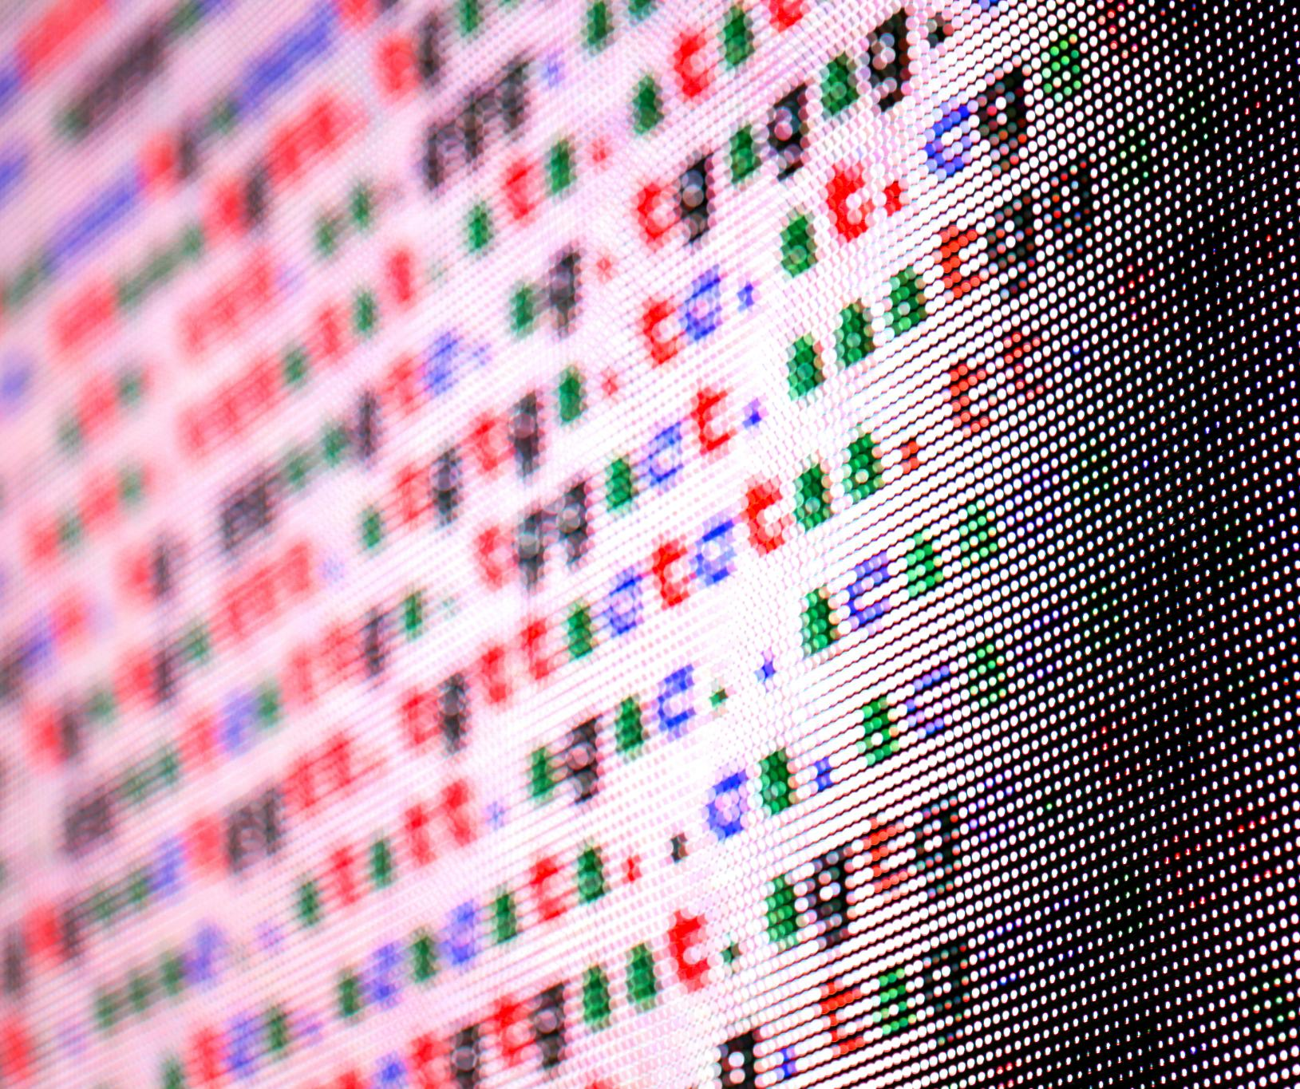
CIFAR-10 Unsupervised Machine Learning
Jayjit Pradhan
May, 2025

Slide 2

Agenda Items
Project & Problem Description
Data Description and Load
Data Clean-Up and EDA
Data Preprocessing
Model Build
Model Comparison
Summary

Slide 3

Project and Problem Description
As part of DTSA-5510 Unsupervised Algorithms in Machine Learning course for Master of Science in Data Science from University of Colorado, Boulder, this project is done for classifying CIFAR-10 dataset using unsupervised machine learning algorithms
The CIFAR-10 dataset consists of 60000 32x32 color images in 10 classes, with 6000 images per class.
The classes are—
Airplane, Automobile, Ship, Truck
Bird, Cat, Deer, Dog, Frog, Horse

Slide 4
Data Description and Load

Slide 5
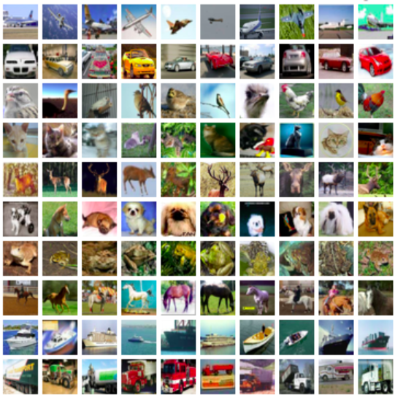
CIFAR-10 Dataset
Dataset Overview
CIFAR-10 consists of 60,000 images divided into 10 distinct classes for classification tasks.
Image Classes
Each class in the CIFAR-10 dataset contains 6,000 labeled images, facilitating robust training and testing of models. Each image in the CIFAR-10 dataset is 32x32 pixels in RGB format, making it suitable for various algorithms.
Benchmarking Tool
CIFAR-10 is widely used as a benchmark for evaluating machine learning algorithms in image classification tasks.
Keras Dataset
For this project CIFAR-10 dataset have been loaded from Keras Datasets.

Slide 6
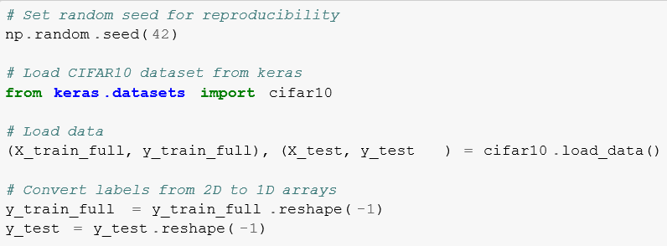
Loading CIFAR10 Dataset
Loading with Keras
To load CIFAR-10 dataset in Keras, I have used the function keras.datasets.cifar10.load_data().
Automatic Train-Test Split
This data load automatically splits the data in Train & Test batches of 50,000 & 10,000 images respectively.
Image Properties
Each image in the Train & test dataset is 32x32 pixels in RGB format, having a pixel value range from 0-255.

Slide 7
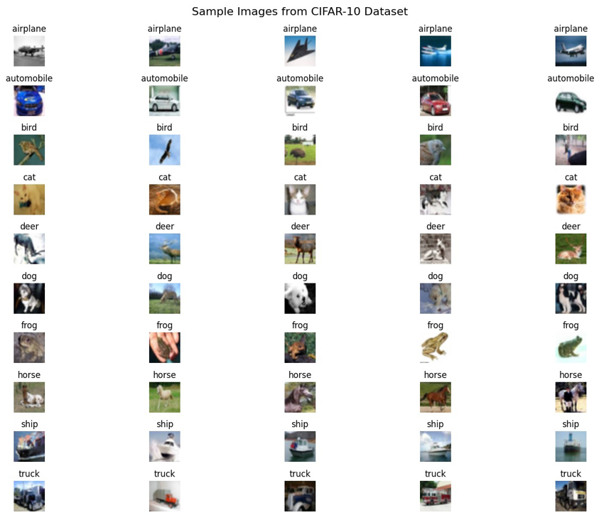
Sample Images from CIFAR-10

Slide 8
Data Clean-Up and EDA

Slide 9

Data Clean-up
No data clean-up are done on Keras CIFAR10 data as—
Pre-curated Dataset
CIFAR-10 is a well-established, carefully curated benchmark dataset that has already undergone quality control. Unlike real-world datasets, it doesn’t contain: Missing values, Corrupted images, Mislabeled samples or Inconsistent formatting
Uniform Image Properties
Each image in the Train & test dataset is 32x32 pixels in RGB format, having a pixel value range from 0-255.
Balanced Classes
CIFAR-10 has exactly 6,000 images per class (balanced distribution), so no class imbalance handling was required.
Nature of Image Data
Unlike tabular data, images typically don’t have issues like Outliers, Categorical value encoding, Date/time field conversions etc.

Slide 10
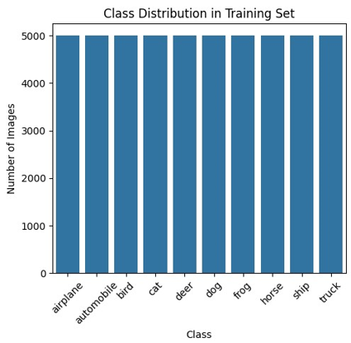
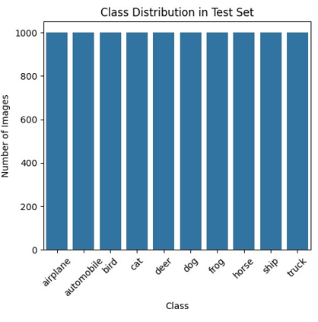
Class Distribution in CIFAR-10
Understanding the distribution of classes is crucial for model training.
Each class in CIFAR-10 contains 6,000 images. 5000 images in training set and 1000 images in test set.
Balance in class distribution helps in benchmarking model performance.

Slide 11
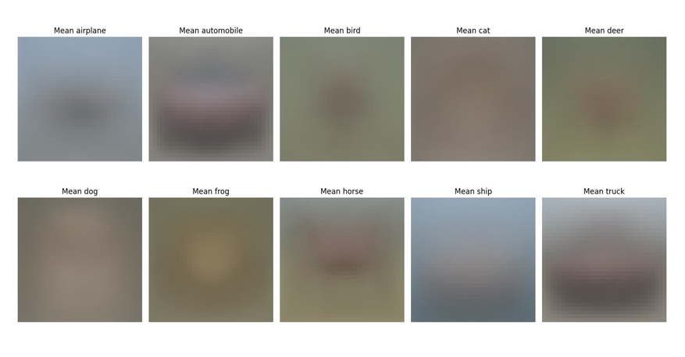
Visualizing Mean Images
Visualizing mean images per class highlights common features.
Mean images are computed by averaging pixel values.
Useful for identifying class-specific characteristics such as—
Mean airplane/ship images show a distinctive cruciform shape on a blue background
Mean automobile/truck images reveal horizontal shapes with visible wheel positions
Mean animal images (cats, dogs, deer) show basic body outlines with common postures –
The frog mean image typically shows a top-down view with a distinctive silhouette

Slide 12
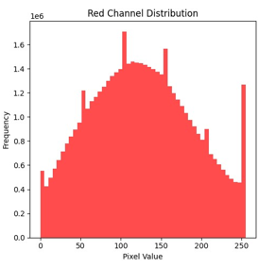
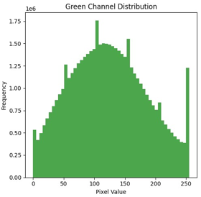
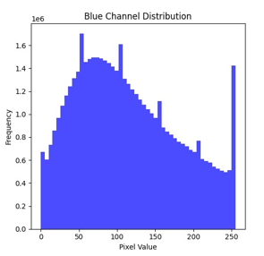
Pixel Value Distribution Analysis
Pixel values range from 0 to 255 in RGB images.
Understanding pixel value distribution aids in normalization.
Visual inspection show all the RGB channels have similar pixel value distribution.

Slide 13
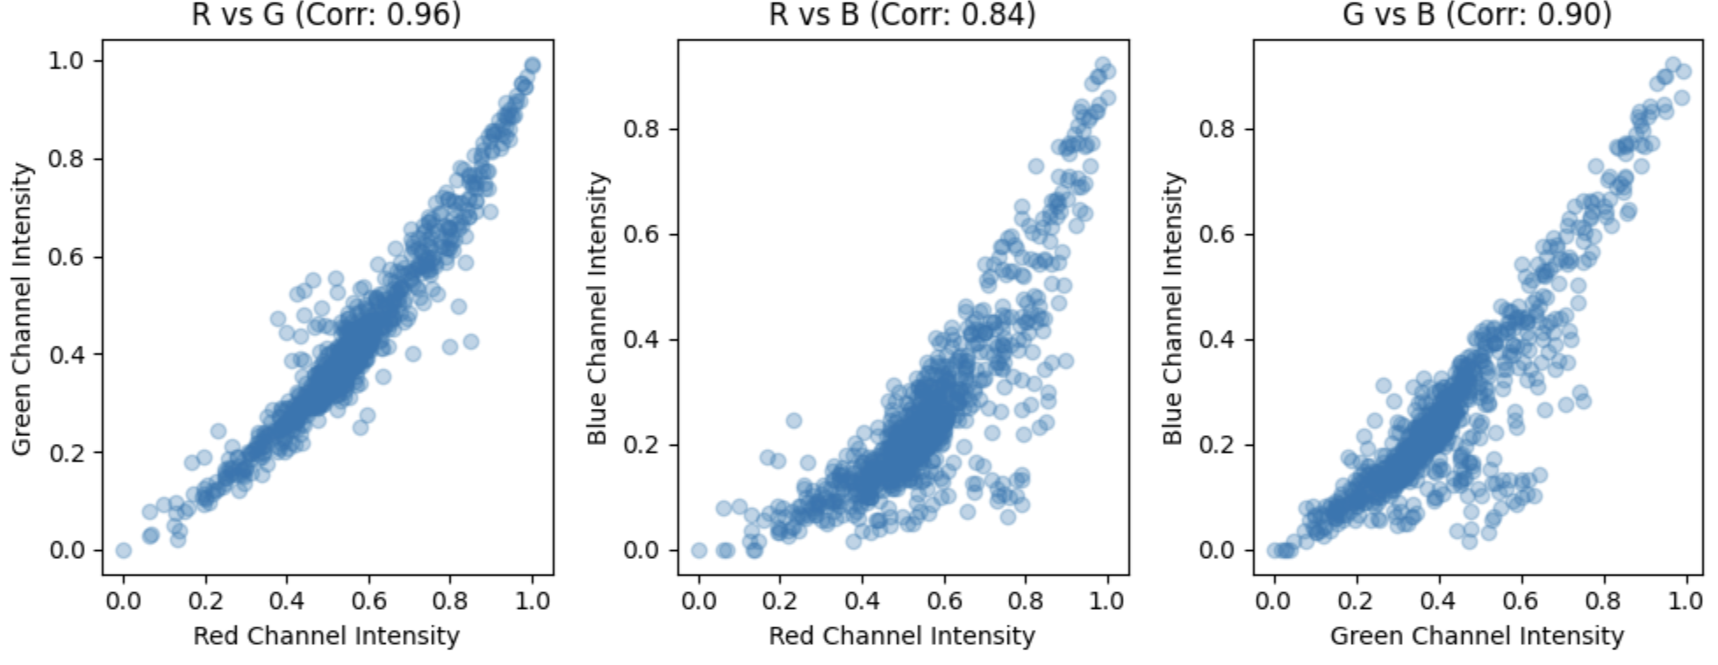
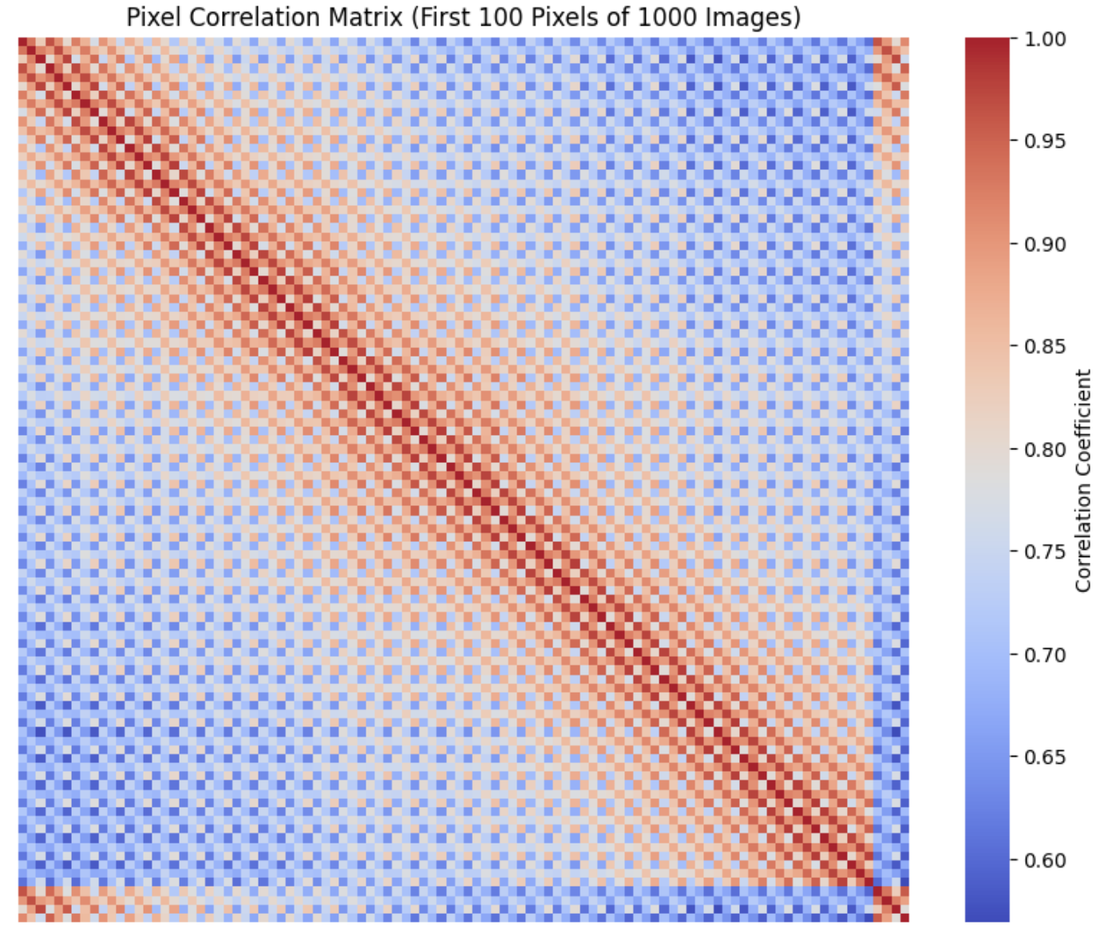
Pixel Value Correlation Analysis
High positive correlation between color channels suggest that the intensity values in these channels tend to vary together.
High positive correlation between nearby pixels is expected because neighboring pixels in an image often have similar color intensities.
Low correlation between distant pixels is also seen.

Slide 14
Data Preprocessing

Slide 15
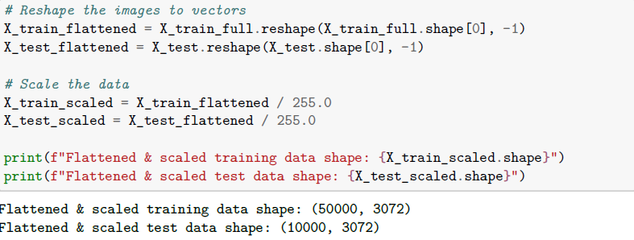
Flattening & Scaling the Data
Flattening transforms multi-dimensional arrays into one-dimensional arrays.
Scaling normalizes data to a common range. By diving the data with max pixel value 255 this is done.
Improves convergence speed in training algorithms.

Slide 16
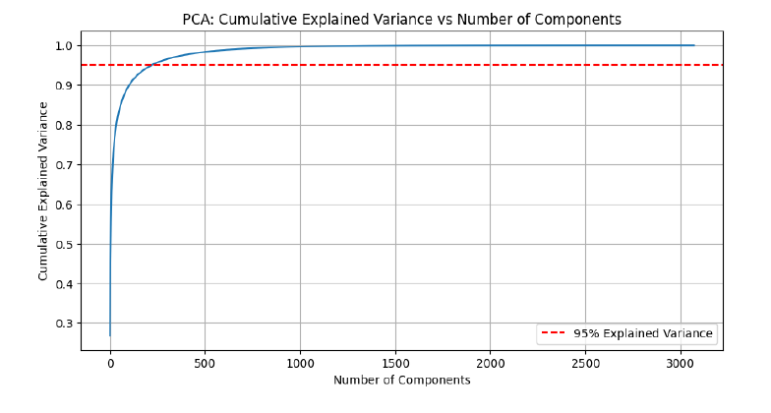
Dimensionality Reduction with PCA
PCA reduces the number of features while retaining variance.
Helps in visualizing high-dimensional data.
Aids in reducing overfitting in models.
Using 95% explain variance, number of features are reduced from 3072 to 217.

Slide 17
Model Build

Slide 18
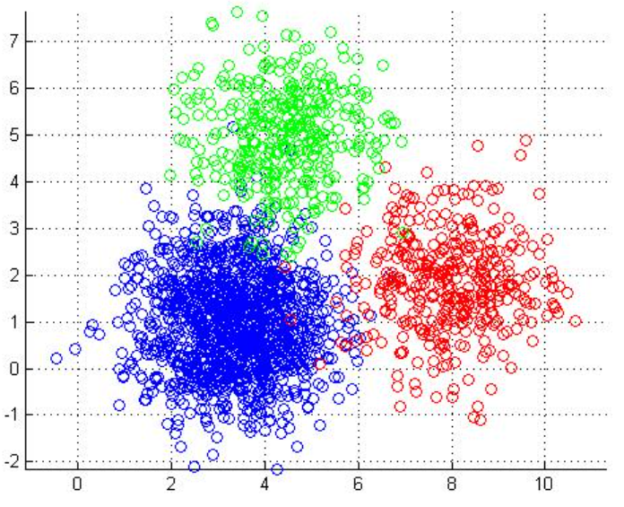
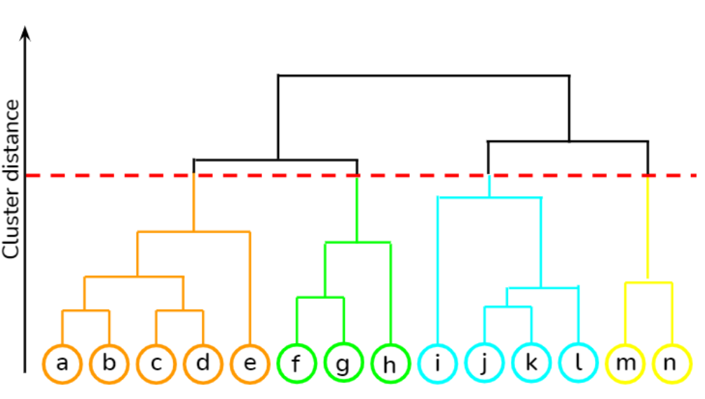
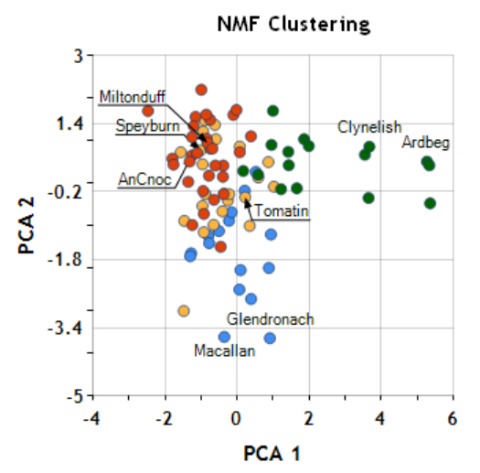
Choice of Algorithms
K-Means Clustering
K-Means efficiently partitions the high-dimensional image data into k distinct clusters. This algorithm works well for discovering natural groupings in the image space based on pixel similarities.
For CIFAR-10’s diverse object categories, K-Means can identify visual patterns that often correspond to semantic categories (like animals or vehicles) without requiring labels.
Hierarchical/Agglomerative Clustering
It provides valuable insights into the multi-level structure of CIFAR-10 data by creating a nested hierarchy of clusters. Unlike K-Means, it doesn’t require specifying the number of clusters beforehand, allowing to explore different clustering granularities through dendrogram visualization.
This flexibility is particularly beneficial for understanding relationships between image categories in CIFAR-10, potentially revealing how classes like “automobile” and “truck” might be more closely related than “automobile” and “bird.”
Non-Negative Matrix Factorization (NMF) + K-Means Clustering
NMF is particularly suited for CIFAR-10 because it can decompose the image data into interpretable components that often align with meaningful visual features. By factorizing the image data into two non-negative matrices, NMF identifies parts-based representations that correspond to distinctive visual elements present across the dataset.
For CIFAR-10’s natural images, these components might represent features like textures, shapes, or color patterns that make up objects like cars, planes, or animals. The additive nature of NMF aligns well with how natural images are composed, making the results more interpretable than many other dimensionality reduction techniques.

Slide 19

Training & Validating Models
Hyperparameter Tuning
Hyperparameter tuning is done for selected algorithms.
Training Models
With hyperparameter tuned parameters, models are trained with training image data set.
Performance Matrix
Silhouette Score is used for evaluation of these clustering algorithms as it measures how similar objects are to their assigned cluster compared to other clusters.
Cluster Visualization
t-distributed stochastic neighbor embedding (t-SNE) dimensionality reduction technique have been used to visualize cluster separation

Slide 20
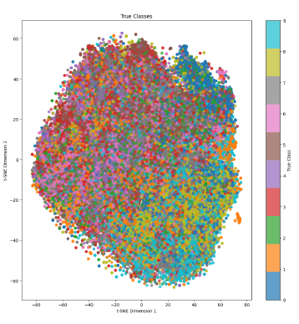
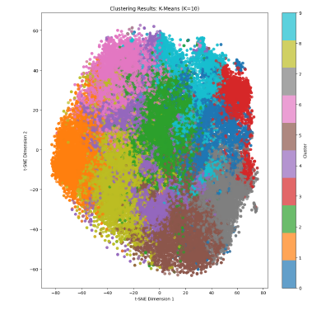
K-Means Clustering
Optimal Clusters
K-Means Clustering model created with 10 clusters as the CIFAR10 data have 10 classes.
Silhouette Score
K-Means Clustering silhouette score is 0.0545.
Visualization Clusters
t-distributed stochastic neighbor embedding (t-SNE) dimensionality reduction technique have been used to visualize cluster separation

Slide 21
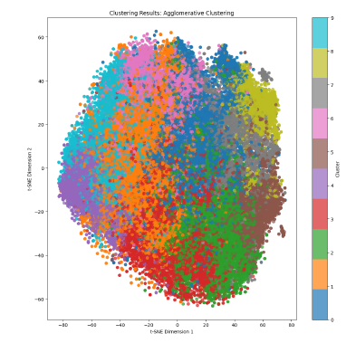
Hierarchical/Agglomerative Clustering
Optimal Linkage
Hierarchical/Agglomerative Clustering model created with 10 clusters as the CIFAR10 data have 10 classes with optimal linakge ‘ward’.
Silhouette Score
Agglomerative Clustering silhouette score: 0.0195.
Visualization Clusters
t-distributed stochastic neighbor embedding (t-SNE) dimensionality reduction technique have been used to visualize cluster separation

Slide 22
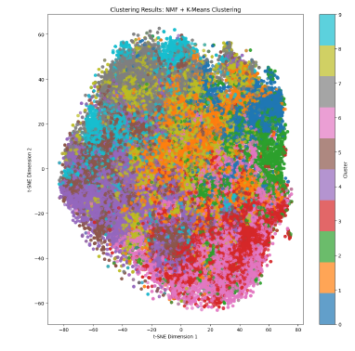
Non-Negative Matrix Factorization (NMF)
Optimal Clusters
NMF + K-Means Clustering model created with 10 clusters as the CIFAR10 data have 10 classes.
Silhouette Score
NMF + K-Means Clustering silhouette score: 0.0077.
Visualization Clusters
t-distributed stochastic neighbor embedding (t-SNE) dimensionality reduction technique have been used to visualize cluster separation.

Slide 23
Model Compare

Slide 24
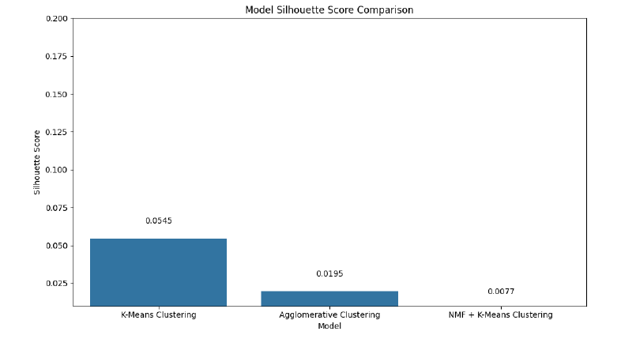
Comparing Model Performances
Evaluation Metrics
Using Silhouette score in validation set model performance is compared.
Visualizing Results
Looking at the results it is evident that K-Means clustering performed the best with silhouette score as 0.0545 on training set.

Slide 25
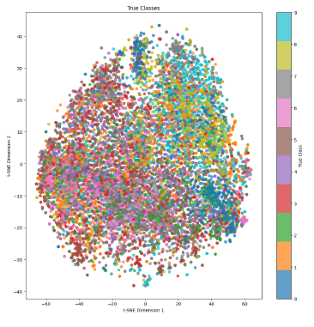
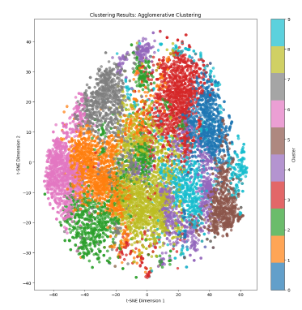
Best Model Validation on Test set
Silhouette Score
With the test set K-Means Clustering model gave silhouette score of 0.0532 suggesting a generalized model.
Visualization Clusters
t-distributed stochastic neighbor embedding (t-SNE) dimensionality reduction technique have been used to visualize cluster separation.

Slide 26
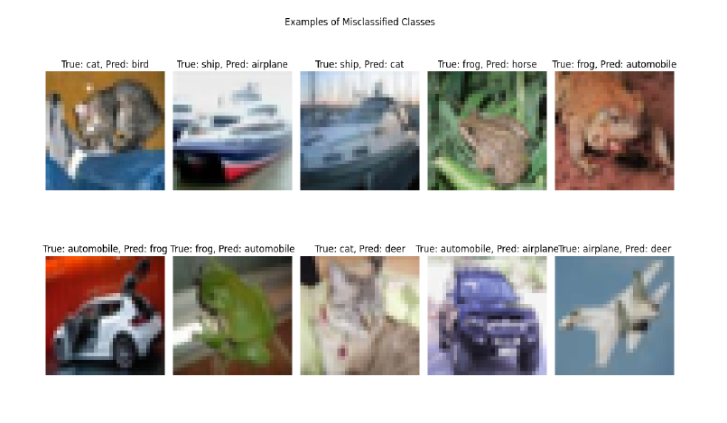
Misclassified Samples

Slide 27
Summary

Slide 28

Analysis of Model Performance
K-Means Clustering
K-Means clustered the images into 10 distinct groups, but the clusters don’t perfectly align with the true CIFAR-10 classes. Although the algorithm identified patterns based on color and shape similarities, but some clusters were dominated by specific classes, showing that K-Means did capture some semantic meaning. The visualization of cluster centers revealed interesting “average” representations of each cluster.
Hierarchical/Agglomerative Clustering
The hierarchical approach yielded different results based on the linkage method, with Ward linkage generally performing best. Compared to K-Means, Agglomerative Clustering tended to create more imbalanced clusters. The hierarchical structure provides additional insights into the relationships between clusters.
Non-Negative Matrix Factorization (NMF)
NMF discovered interesting basis components that can be interpreted as “parts” of images. The components captured color patterns, shapes, and textures that appear across the dataset. Using NMF features for clustering (NMF+KMeans) provided a different perspective on the data structure.

Slide 29
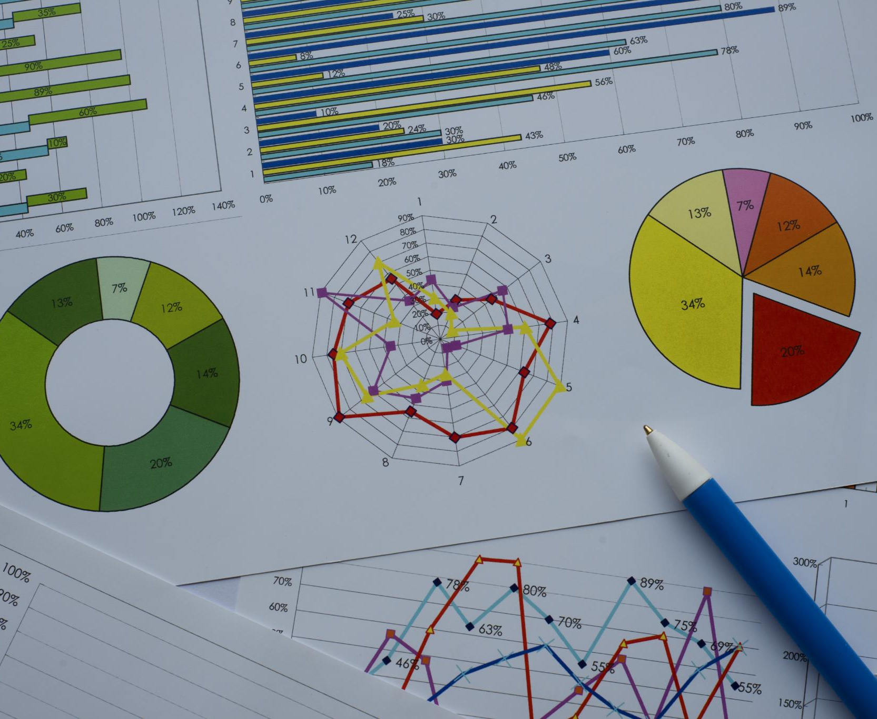
Future Work and Improvements
Feature Engineering
Extract more sophisticated features like HOG (Histogram of Oriented Gradients)
Use more advanced dimensionality reduction techniques like t-SNE
Ensemble Methods
Combining multiple clustering approaches for more robust results
Data Augmentation
Generate additional training samples through rotations, shifts, or elastic distortions
Semi-supervised approaches
Incorporating a small amount of labeled data to guide the unsupervised learning process.

Slide 30

Conclusion
This analysis demonstrated the application of three unsupervised learning techniques to the CIFAR10 dataset. While none of the methods perfectly recovered the human-defined classes, they all revealed interesting patterns and structures within the data without using class labels..
K-Means provided a simple and effective baseline with reasonable computational efficiency. Agglomerative Clustering offered insights into hierarchical relationships but at a higher computational cost. NMF revealed interpretable components that represent common patterns across the dataset.
Unsupervised learning on image data remains challenging due to the semantic gap between pixel level features and human-defined categories. However, these methods provide valuable tools for exploring and understanding complex datasets when labels are unavailable or expensive to obtain..

